Slide 1
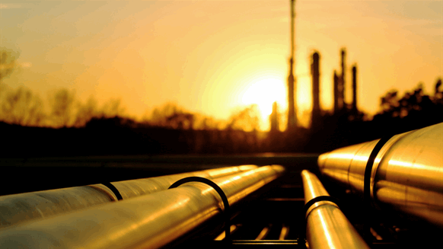
Pipeline Incident

Slide 3
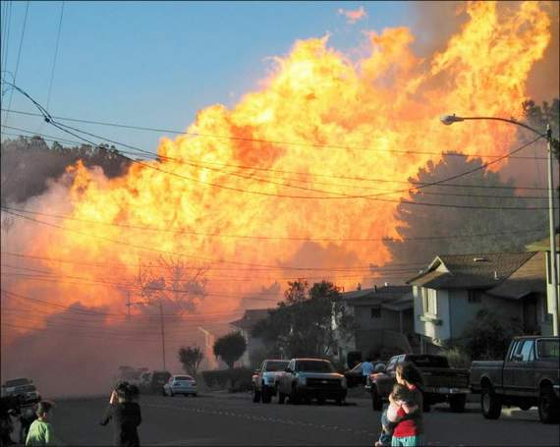
Objectives
Recognize hazards associated with cleanup in the aftermath of a pipeline incident.
Assess hazards of assigned tasks to ensure safety and health of site workers.
Identify precautions and control measures to control identified hazards.

Slide 4
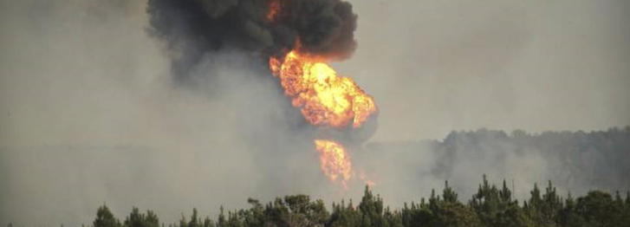
facts
Over 280 significant pipeline incidents occur in the US every year.
These incidents often result in serious losses to property, infrastructure, and sometimes even a loss of human life.
2.7 million miles of pipeline in the United States. Texas tops the list of states when it comes to pipeline explosions. In fact, Houston ranks as the most dangerous city in the United States when it comes to gas pipeline leaks.
Notes:
Floods can be serious catastrophes and they are one of the most common hazards in the United States. Floods can be caused by a variety of factors, including a sudden accumulation of rain, rising rivers, tidal surges, ice jams and dam failures.

Slide 5
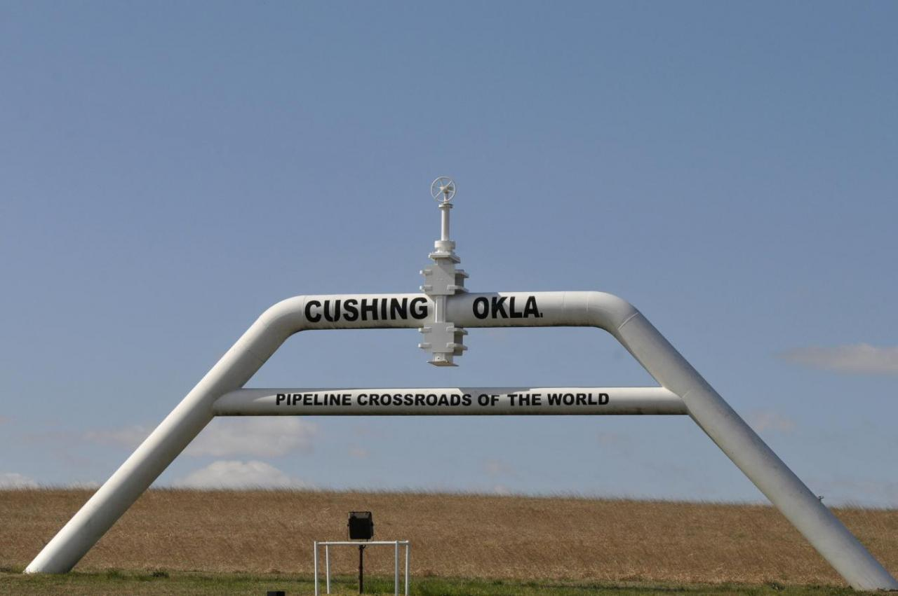
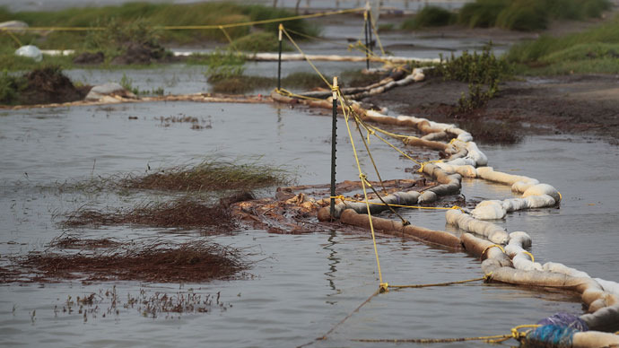
fact
Sweetwater, TX 8600 (2662 in chart)
Worst pipeline disaster of 2016 could be one of the least talked about, despite leaking 361,200 gallons of crude oil.
Cushing, Oklahoma
Enterprise Pipeline carries 400,000 barrels of crude oil per day from storage hubs in Oklahoma all the way to refineries on the Gulf Coast. But in October 2016, a pipeline ruptured and sprayed the area with crude oil, a known cause of chemical pneumonia. There were no injuries or evacuations, so the spill was quietly cleaned up after it leaked some 307,734 gallons of crude oil.

Slide 6
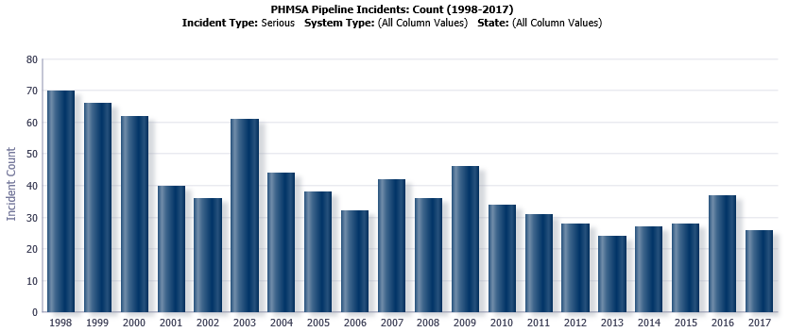
Pipeline
Primary Hazards
Chemical Hazards
Fires/Explosions
Environmental Contamination

Slide 7
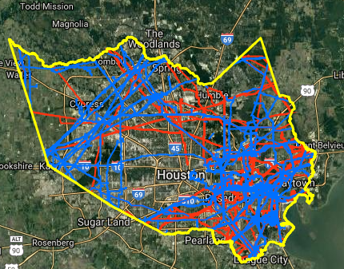
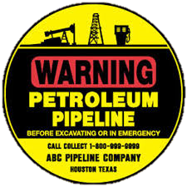
Pipeline
Complex network of pipes transmitting products all over the United States.
Varies in product, pipe size, and PSI.
Notes:
Workers can expect to find standing water present throughout a flood zone. If water has been present anywhere near electrical circuits and electrical equipment, turn off the power at the main breaker or fuse on the service panel. Never enter flooded areas or touch electrical equipment if the ground is wet.
Workers repairing downed electrical lines must be aware of the hazards associated with maintenance on overhead lines, as well as the potential for emergency conditions to create additional hazards. Such work must be performed by utility company workers or other properly trained workers. Potential hazards include:
Electrocution by contact with downed energized lines, or objects in contact with fallen lines.

Slide 9
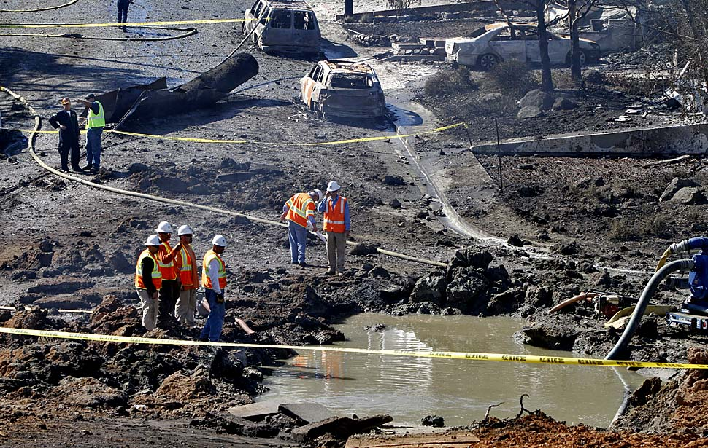
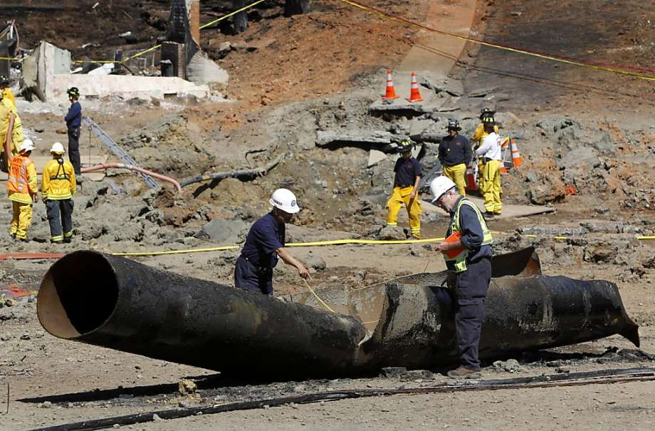
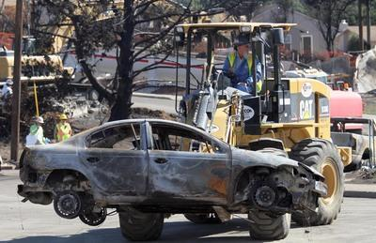
Response Worker Precautions
Fires/Explosions
High flammability of product creates potential for fire or explosion.
Notes:
Chemical and biological hazards
Liquefied Petroleum Gases (LPG) and underground storage tanks, along with other chemical containers, may break away and float downstream, causing hazards from their released contents. Floodwaters may also contain biohazards due to direct contamination by untreated raw sewage, dead animals, rotting food, etc. Avoiding contact, good personal hygiene practices, medical surveillance, and discarding all food that comes in contact with flood waters are all important controls.

Slide 10
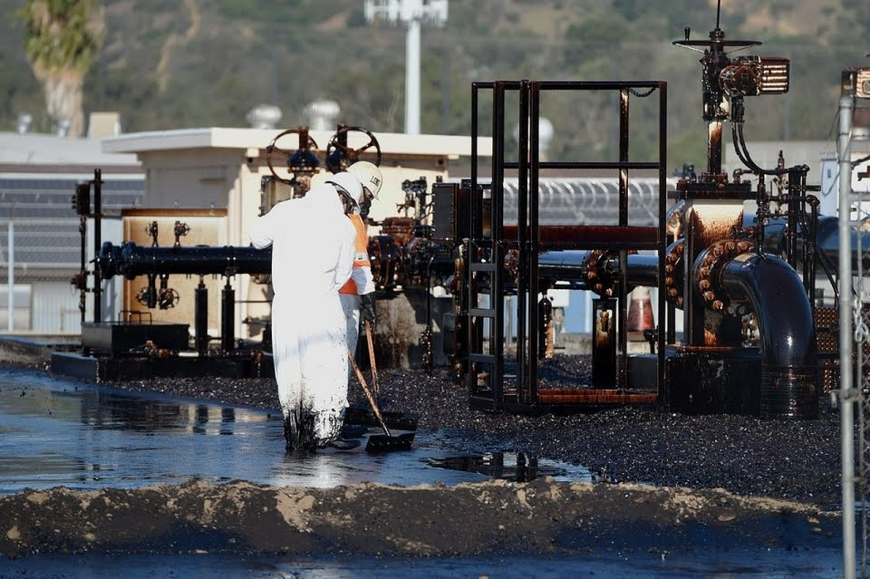
Response Worker Precautions
Chemical Hazards
Natural Gas, Crude Oil, and other flammable materials are moved through pipelines.
Chemical information is needed for workers to appropriately plan for risks resulting from a pipeline incident.
Photo above shows cleanup crews at the pumping station in Los Angeles where a failed valve released between 10 and 20 thousand gallons of crude oil on May 15, 2014
Notes:
Chemical and biological hazards
Liquefied Petroleum Gases (LPG) and underground storage tanks, along with other chemical containers, may break away and float downstream, causing hazards from their released contents. Floodwaters may also contain biohazards due to direct contamination by untreated raw sewage, dead animals, rotting food, etc. Avoiding contact, good personal hygiene practices, medical surveillance, and discarding all food that comes in contact with flood waters are all important controls.

Slide 11
References
Pipline and Hazardous Material Safety Administration (PHMSA)
https://www.transportation.gov/pipelines-hazmat

Slide 12
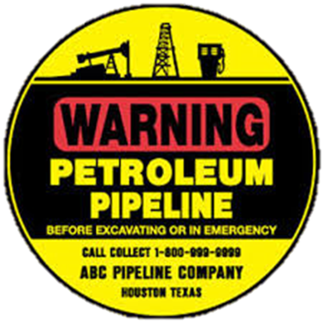
activity
What are the THREE primary hazards to site workers involved in cleanup following a pipeline incident?
CHEMICAL HAZARDS
FIRE & EXPLOSIONS
ENVIROMENTAL IMPACTS

Slide 13
activity
Use the Safety and Health Checklist to complete:
Hazard Recognition
Probability
Severity
Risk
Apply the Hierarchy of Health & Safety Controls

